Slide 1
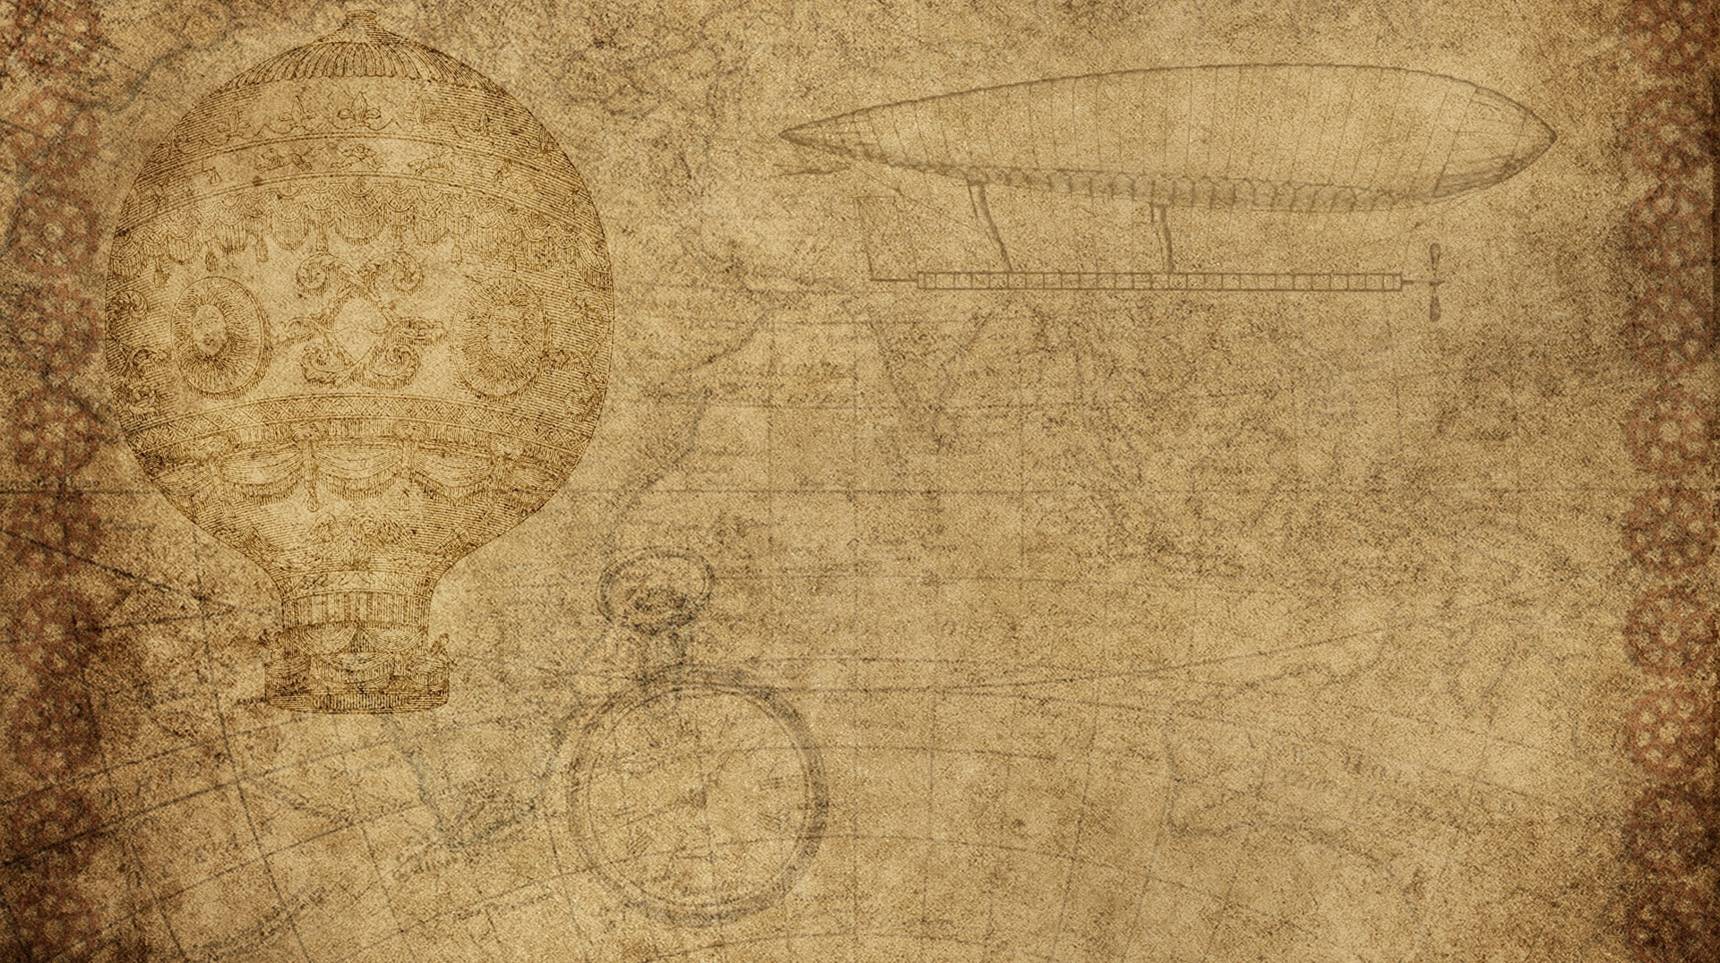

DOC ON CLick

Slide 2
Group Members
Group Leader :
Sohaib Azhar (172095)
Group Members :
Mahad (172077)
Waleed Ahmad (172096)
Adnan Bin Zafar (172100)
Jahanzaib Ali (172063)
Usman Anwar (172092)

Slide 3
Introduction
Doctors are now one click away.
The main purpose of this project is that people can make appointments now sitting at their homes.
They don’t have to stand and wait in a queue to make an appointment.
Instead they can look for doctors online without actually going anywhere.

Slide 4
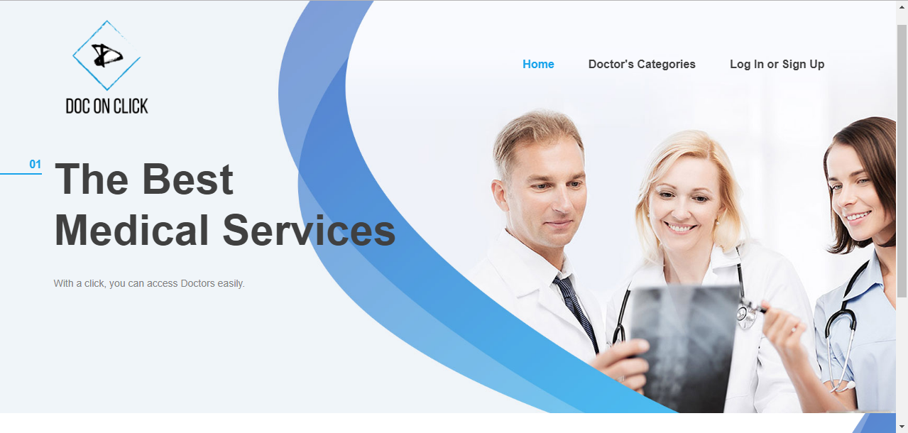

Slide 5
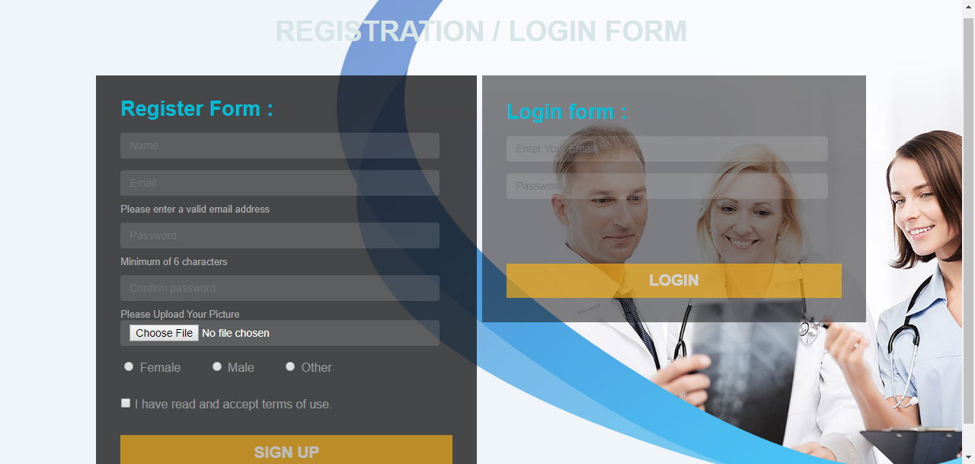
How it works
Users have to sign up to see the doctors’ profiles located in different areas.

Slide 7
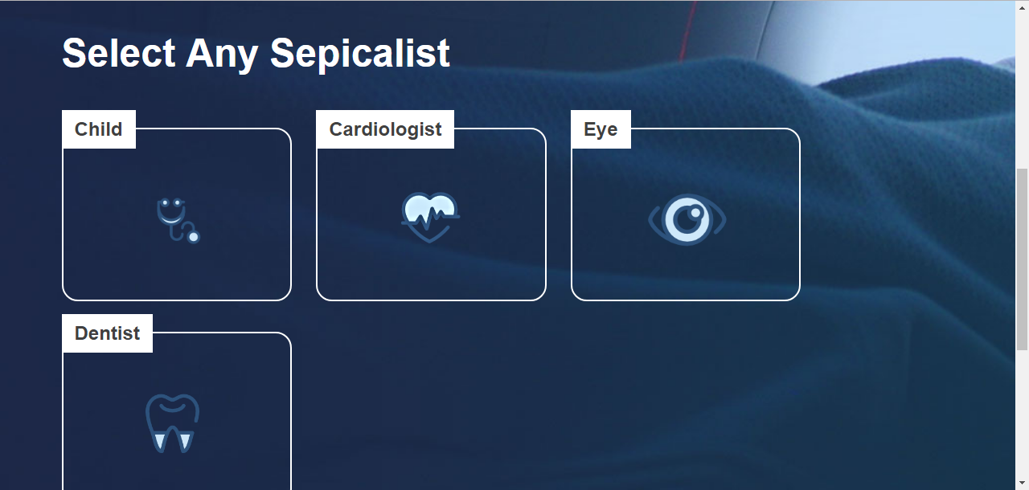

Slide 8
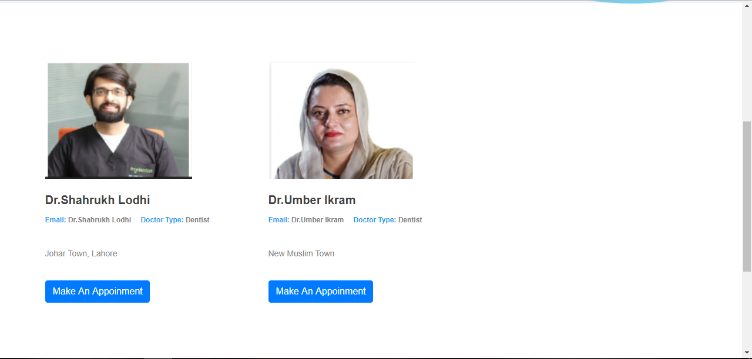

Slide 9
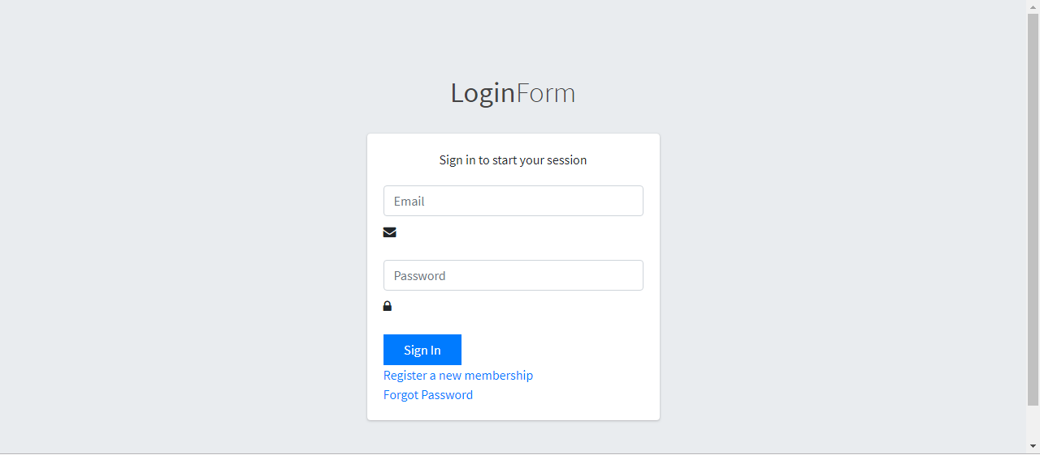

Slide 10
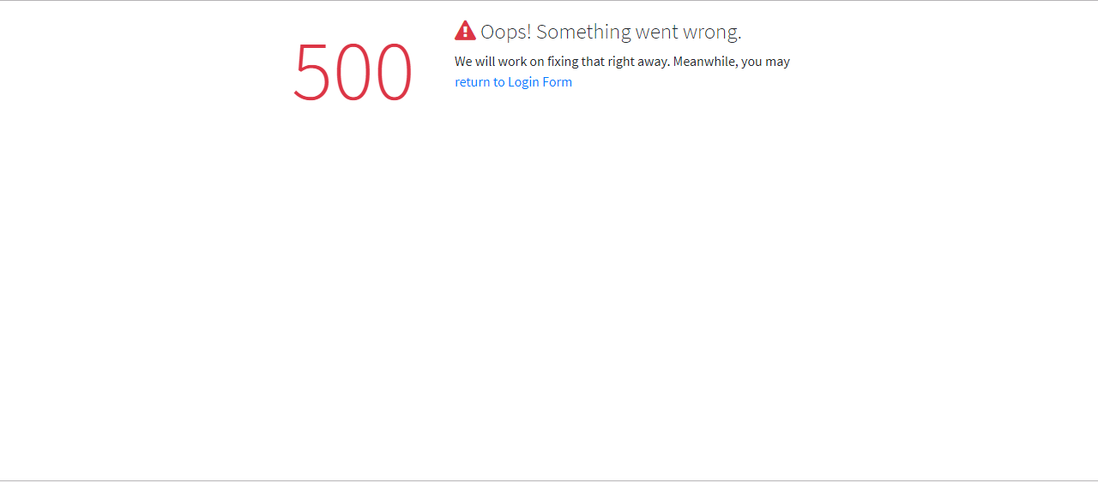

Slide 11
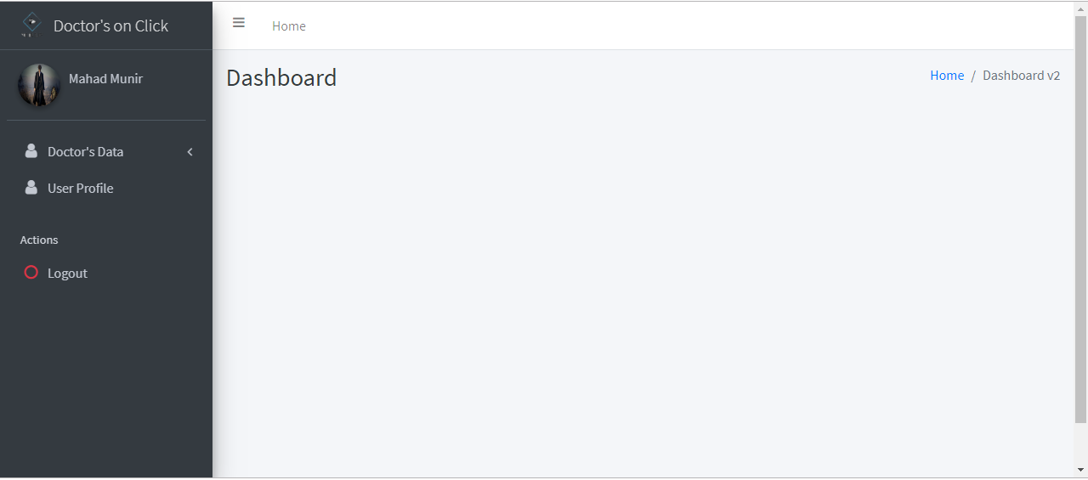

Slide 12
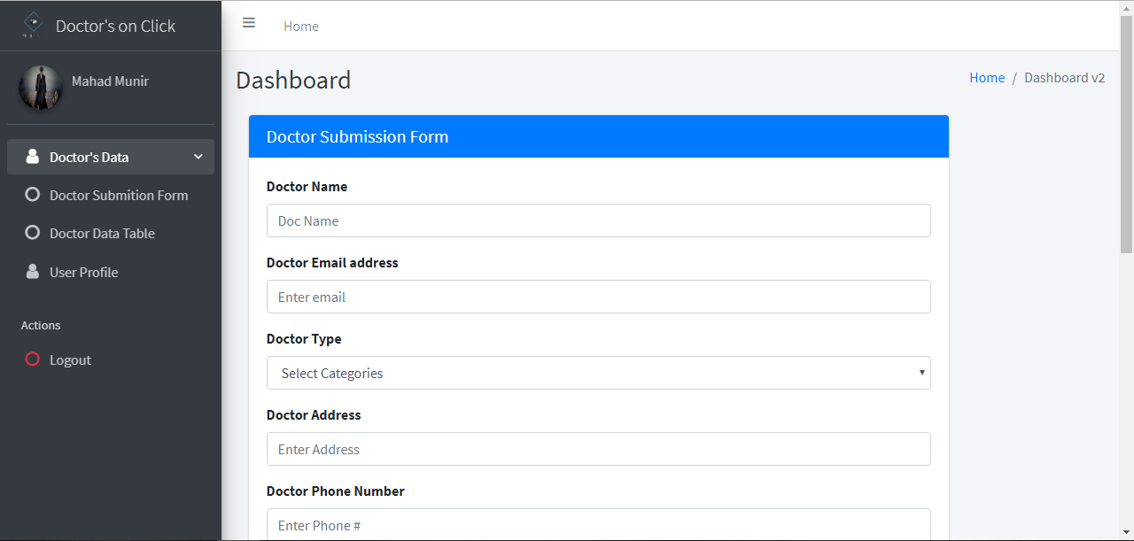

Slide 13
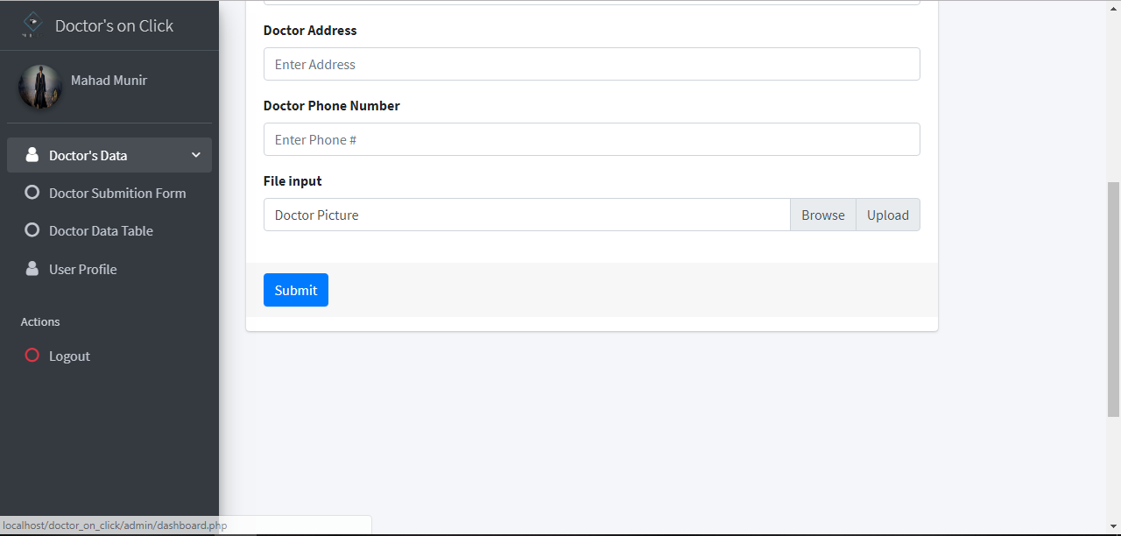

Slide 14
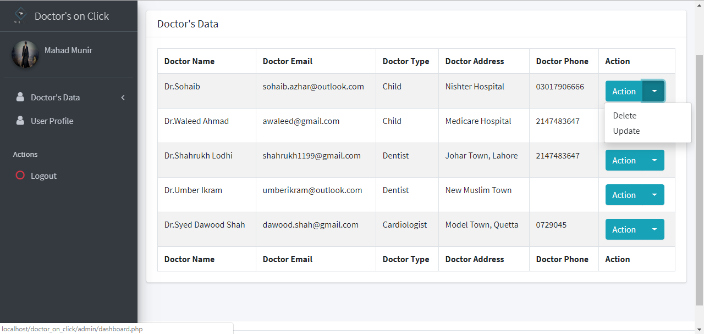

Slide 15
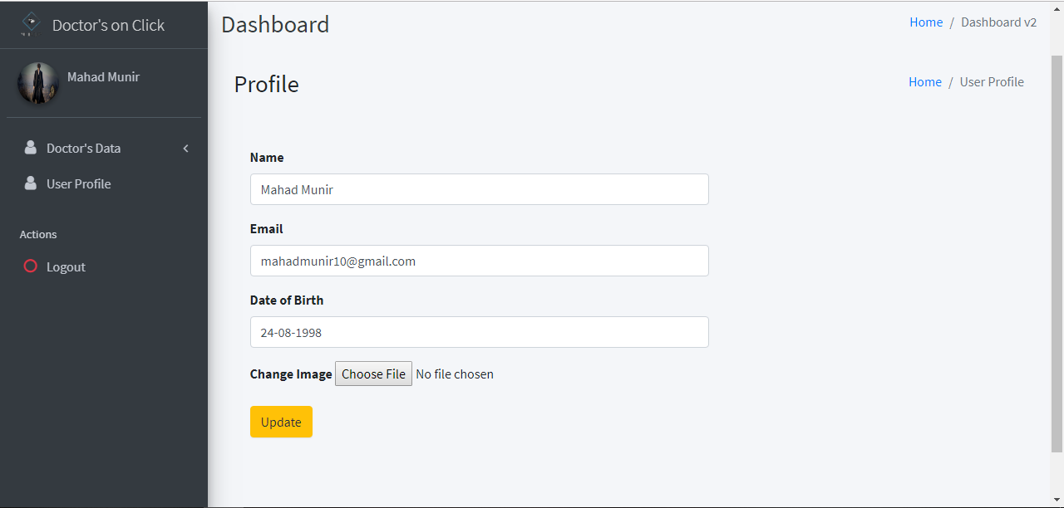

Slide 16


